Slide 1
職場故事
Notes:
大家好，接下來我會跟大家說一個有關於我的故事

Slide 2
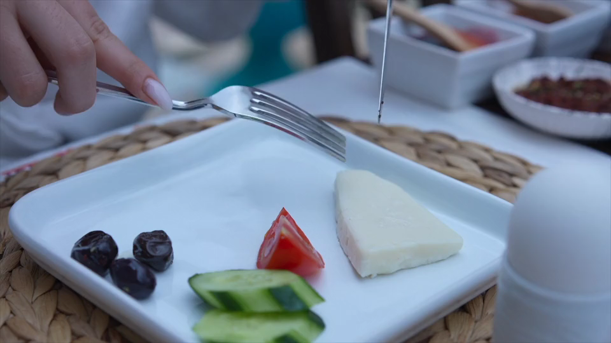
1.目標
Notes:
Breakfast
https://pixabay.com/videos/cheese-bread-breakfast-food-170912/

Slide 3

2.阻礙
Notes:
Raining
https://pixabay.com/videos/rain-raindrop-wet-water-window-28236/

Slide 4
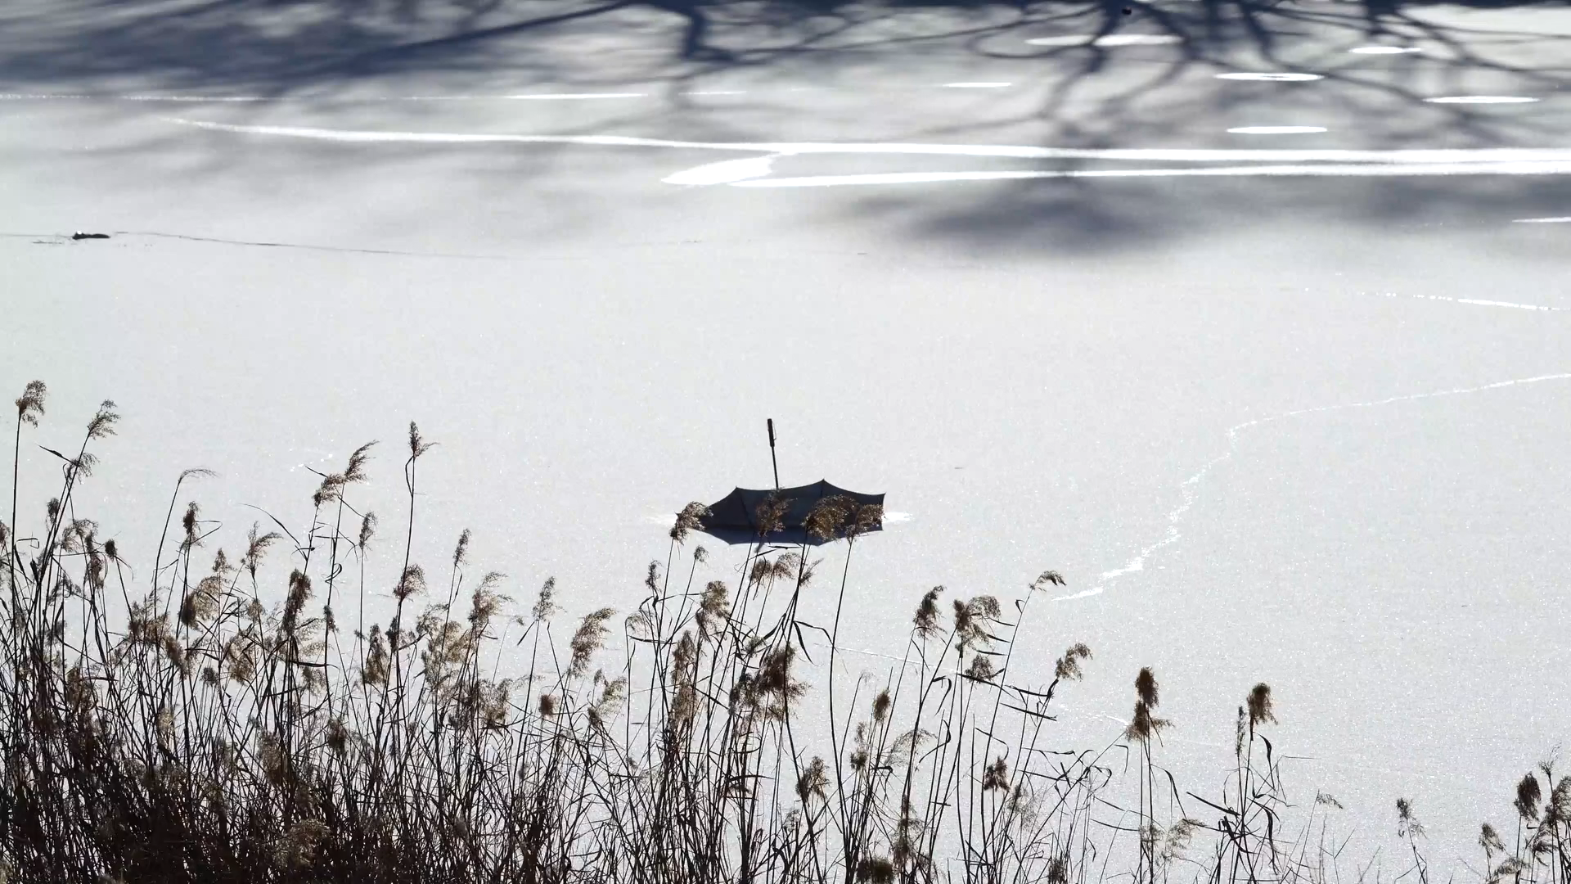
3.努力
Notes:
raining

Slide 5
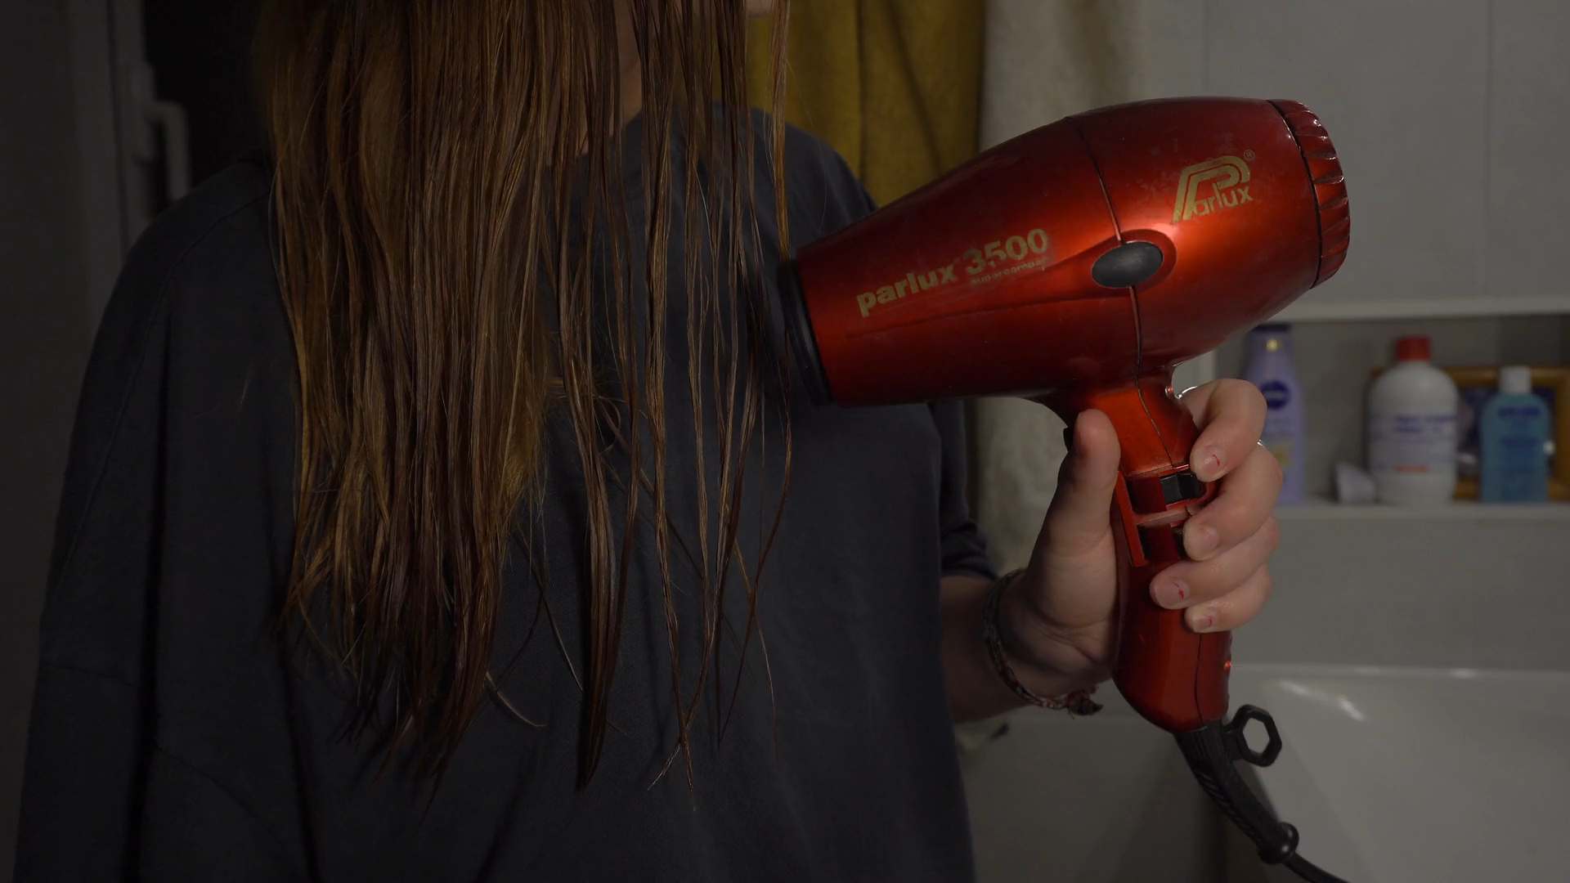
4. 結果
Notes:
https://pixabay.com/videos/hair-dryer-dryer-hygiene-bathroom-34769/

Slide 6
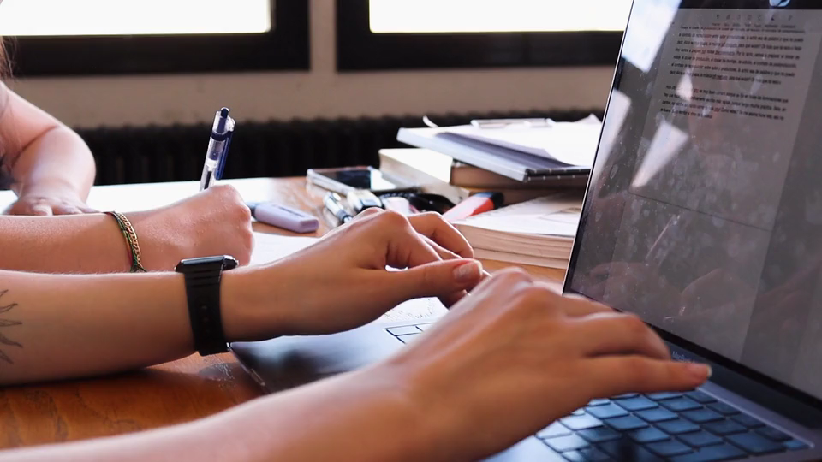
5. 意外
Notes:
https://pixabay.com/videos/hands-typing-keyboard-laptop-159030/

Slide 7

6.轉彎
Notes:
https://pixabay.com/videos/office-secretary-business-work-7269/

Slide 8
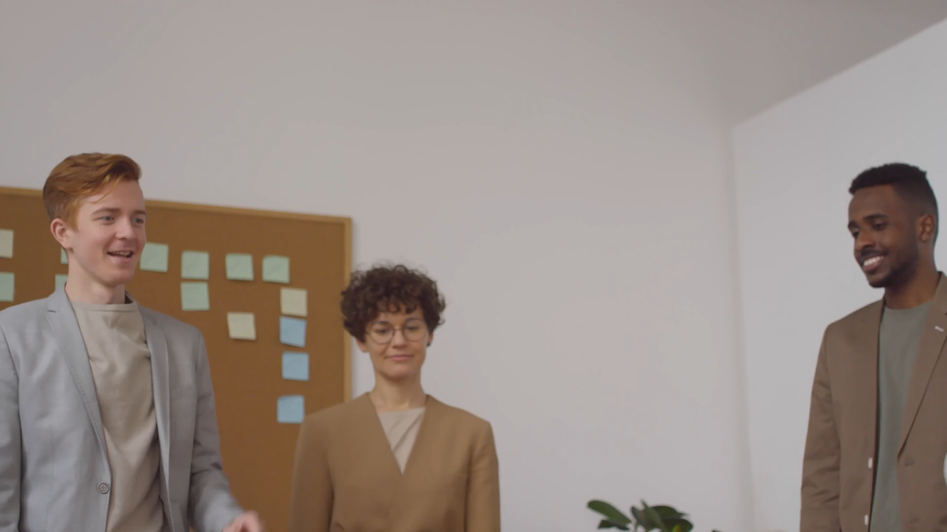
7.結局
Notes:
https://pixabay.com/videos/team-office-work-success-70345/

